Slide 1
CUSTOMER SATISFACTION BASED ON THEIR QUERIES FOR THE BUSSINESS DEVELOPMENT
Project Guide: Mrs Uma.M
1201310056 Mohit Ratnesh
1201310057 Sourabh Agarwal

Slide 2
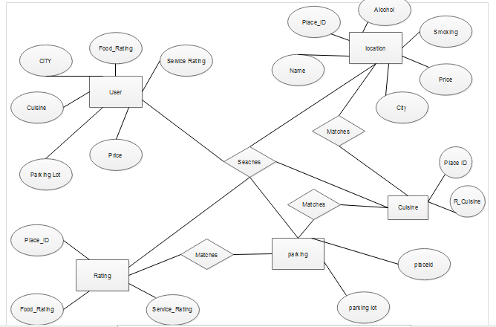
E-R DIAGRAM

Slide 3
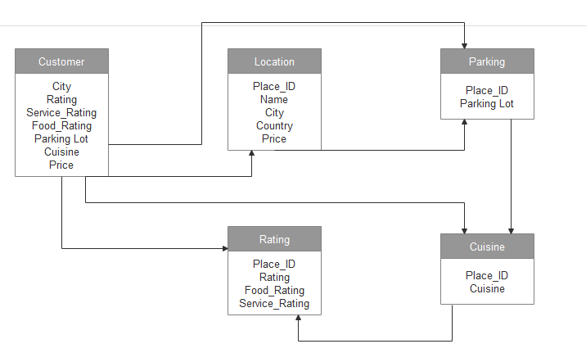
RELATIONAL MODEL DIAGRAM

Slide 4
Technologies Used
Weka 3.8
NetBeans IDE 8.0.2
Oracle 10 G Express Edition
MS Excel
HTML,CSS And JSP

Slide 5
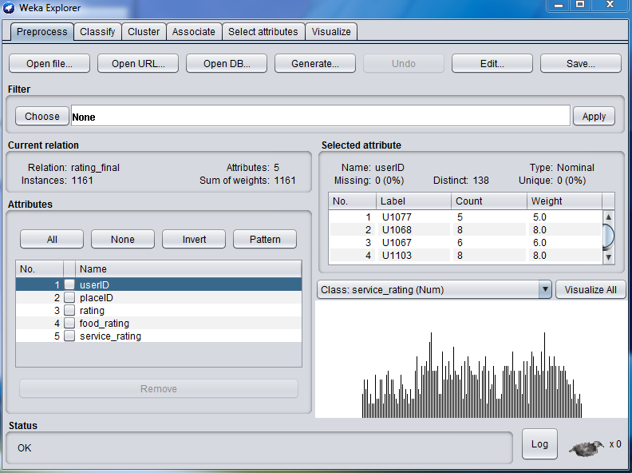
DEMO
DATA MINING (USING WEKA TOOL)

Slide 6
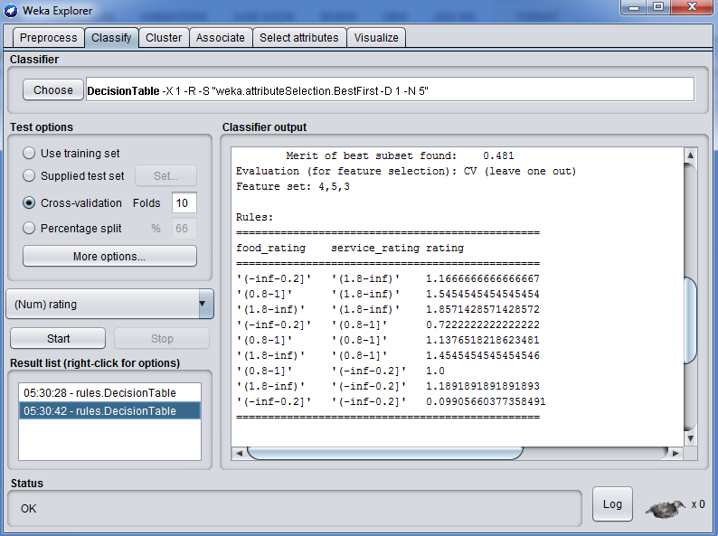
….contd

Slide 7
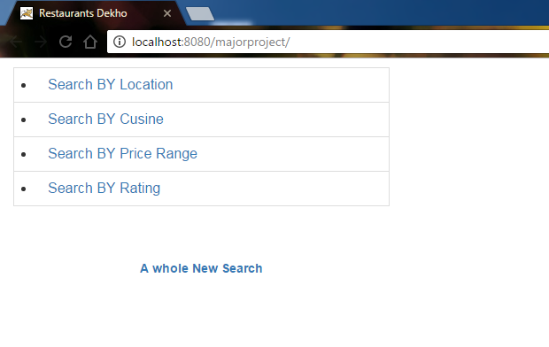
USER INTERFACE

Slide 8
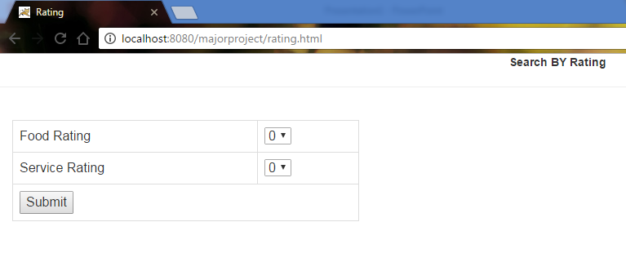
SEARCH BY RATING-UI

Slide 9
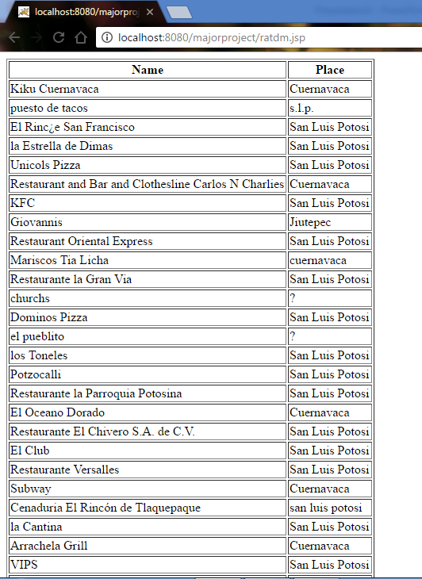
OUTPUT DEMO

Slide 10
UNIT Testing
Test Case ID | TestCase | Procedure | Input | Expected Output | Output | Remarks
RT001 | Selection of rating 0 and 1 | Dropdown selection 0 and 1 | 0 and 1 | Restaurant Lists | Restaurant Lists | Success
RT002 | Selection of rating 1 and 0 | Dropdown selection 1and 0 | 1 and 0 | Restaurant Lists | Restaurant Lists | Success
RT003 | Selection of rating 1 and 1 | Dropdown selection 1 and 1 | 1 and 1 | Restaurant Lists | Restaurant Lists | Success
RT004 | Selection of rating 2 and 1 | Dropdown selection 2 and 2 | 2 and 2 | Restaurant Lists | Blank Screen | failed

Slide 11
Equivalence partitioning for Unit testing
File Selected ..\Downloads\Compressed\rating_final.csv
Partitioning :-
Service_Rating
Food_Rating
Rating

